Slide 1
Software Practice II Discussion Section September 16, 2020
Daniel, Josh, and Tajen
TAs

Slide 2
Lab Exercise #1
Git in the shell

Slide 3
What is Git?
Git is a version control system with numerous features
Serves as a backup for any work that you put on it
Allows users to look back at every change made to a codebase and revert to previous versions
Allows multiple existing “branches” of code with different changes
Branches can be created, edited separately by multiple people, and then merged back together

Slide 4
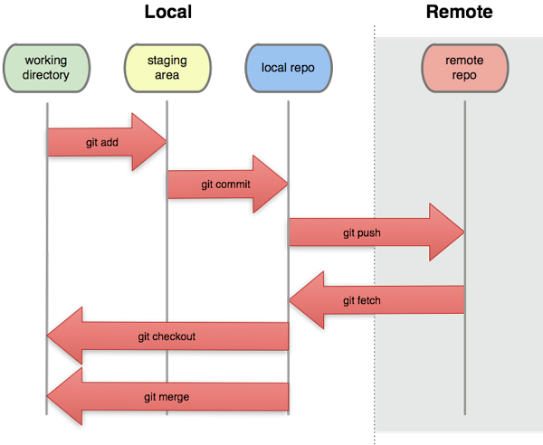
Git Workflow

Slide 5
Git Commands
Git status
Gives information about current branch
Git add [files]
Adds the specified files to the staging area to be committed
Git commit –m [message]
Commits all staged files as a save version
Git push
Sends all local changes to the remote version
Git pull
Pulls all changes from the remote version
Git branch
Creates a new branch
Git checkout
Switches to a new branch

Slide 6
-- Pause --
It’s time to take roll. Wait for TA instructions.
(TAs – make sure to restrict chat to just you before taking roll, then save and send the roll record.)

Slide 7
Lab Exercise #2
Shell Scripting

Slide 8
First, what is the shell?
We know that one process (or program) can start another process (or program)
C/C++ support an ‘exec’ function for starting other programs (as a self-contained process).
A desktop or phone puts a fancy front end on this functionality. You point, click, and an application starts.
We can write our own program for launching and managing other programs.
Let’s not.
A shell is just a program for launching and managing other programs.
There are many different ‘shells’, each with their own style of commands

Slide 9
Shell commands
An ‘interpreter’ is a program that translates keywords (typed or from a file) into actions.
A shell is an interpreter.
Some languages are interpreted (Basic, Perl, Python, etc.)
C++ / Java are not – statements are converted to assembly language and packaged into program files.
In a shell, each typed command is compared against a known list of commands.
If recognized, the shell performs the specified action.
If not recognized, the shell searches for an application to run (and runs it).
It searches folders and files for a matching named application.
See “Search Path”

Slide 10
Shell commands
We’ve seen built-in shell commands:
ls
pwd (or cwd)
jobs
We’ve also run applications (started processes) with the shell.
g++
emacs
A shell script is just another way of supplying commands to a shell.

Slide 11
Let’s check out shell scripts…
Change into a homework directory/folder.
Edit a text file named “yeet” (no extension), put this in it:
Save it, change permissions, then run it from the shell:
chmod u+x yeet
./yeet
cd ~ echo “Executing in $cwd” ls -l

Slide 12
Explore this:
What is $cwd
See printenv
Also, your shell scripts can create string variables:
varible=value
$variable expands to the given text
After you run the script, what directory are you in?
This is probably -not- what you expect.
A script gets executed in a separate shell that loses it’s state/variables when the shell ends.
Use this to execute the commands in the current shell:
source ./yeet

Slide 13
Selecting a shell to run your script
There are many different shells
csh, tcsh, sh, bash, Windows Powershell, cmd, terminal, etc.
Each shell has different syntax for:
Using / expanding variables and arrays
Looping commands
Conditional commands
Etc. (ouch! – That would be a lot to learn!)
In your shell script, you may select a preferred shell for your script.
(Not on Windows – Linux only)
The first line of the script specifies the desired execution shell.

Slide 14
Try the following:
Edit your script and add the following comments:
#!/usr/bin/bash # This is my script. cd ~ echo “Executing in $cwd” ls -l

Slide 15
How did that change anything?
When the script was loaded, the first line was checked by the current shell.
The first line started with #!
A path to an executable was found
The current shell launched the specified shell (bash)
The script was run in the new shell.
Always specify the desired shell in your personal shell scripts.
You’ll only need to learn the peculiars of one shell to get started.
‘bash’ is widely popular and a good choice for portability.
Python is a widely popular choice (not taught/covered here)

Slide 16
Seeing that it works.
The shell variable $$ is the process ID of the current shell.
echo “$$”
The ‘ps’ command lists processes (and their IDs for the current user:
ps
We can ask the ‘ps’ command to just list one process, by process number:
ps -p “$$”
We can further restrict the output of the ‘ps’ command:
ps -cp “$$” –o command=“”

Slide 17
Example continued
Use the command to print out the current shell at the command line.
Now, put the command in your script and verify a different shell has started.
You can also echo the process ID of your shell(s) to verify that they are indeed different shells.

Slide 18
Imagine the uses…
Scripts are great for complex, commonly repeated tasks:
Copying or renaming files
Launching programs that take lots of options
Helping with complex source code repository tasks
Controlling processes and limiting resource usage
Choosing (based on conditions) which program to launch
Scripts allow many useful options
Capturing output, supplying input
Loops, conditionals, variables, tests on files
Subshells, sub-scripts

Slide 19
Making your own scripts
Create a directory to hold your scripts
Make sure it is only accessible/writeable by you!
You don’t want others putting commands in your scripts.
I use $HOME/bin, or /home/pajensen/bin
Put a script in the directory.
Change its permissions to include execute permission.
Add the directory to your search path (next slide).
When completed, you (and only you) can then run your scripts from any directory.

Slide 20
Startup script
When you log in, startup script(s) run.
The filename varies based on the startup shell.
I personally edit ~/.cshrc and put commands there.
Other possibility: ~/.login
Other possibility: ~/.tcshrc
Caution! Messing up your login scripts can have significant consequences…
Make sure they have execute permissions
Make sure only you can edit them
Never ‘exit’ from your login script, or logging in will immediately log out again.
Keep changes simple until you’re more experienced.
Ask the CADE help desk to delete your login script if you mess it up.

Slide 21
Startup script
Do not specify a shell in your login script.
It should run in the current shell.
To test your login script:
Put an echo statement in your script, then log in again.
You should see your echo statement.
Try echoing your path:
echo $PATH
To add to your search path, append to it:
setenv PATH $PATH\:$HOME/bin

Slide 22
A few other critical concepts
When a command is executing, ctrl-c will kill it.
When a lot of output is showing up:
Ctrl-s will pause it
Ctrl-q will resume
Suspending jobs can be useful
Ctrl-z to suspend. Use fg or bg to resume.
Sometimes the shell seems to freeze.
The first thing I try with frozen output is ctrl-q.
I accidentally hit ctrl-s on a regular basis.
The second thing I try is patience – gotta let the program finish.
The third thing I try is ctrl-c.

Slide 23
Wow, this is a lot to learn!
Most programmers learn just enough about shell programming to automate or abstract away repetitive tasks.
Use ‘man’ pages: man ps
Use tutorials
Definitely find an online guide to shell programming!
Variables and expansions can be tricky
Shell commands / programs are primitive in comparison to C.
Many programmers have been annoyed by this over the years.
Perl and python arose to create better interpretive/shell like environments.

Slide 24
Surviving
With 35+ years of experience, I (Peter) have a coping strategy:
I quickly forget most specific shell programming, but…
I remember enough about the shell to understand the core concepts:
Useful commands, processes, and jobs
Input, output, redirection, and piping to programs
Variables, loops, and environments
Regular expressions
Almost every time I need a script, I’m back in documentation or tutorials.
I just need to remember how to phrase things or remember how they work. Almost every shell has different syntax.
The autograder is script-heavy, with scripts launching scripts…
I hate that I like shell programming (and like to hate it).

Slide 25
Best ideas/commands to explore:
Input/output redirection and pipes
ls, cp, rm
echo
cat, more, less
find
grep
top, ps, and kill
sed
wc, head, tail
alias
(Some of these could be their own lab…)

Slide 26
End

